Slide 1
CSE 2202 Design and Analysis of Algorithms – I Lecture 9 Algorithm Types Divide and Conquer

Slide 2
Algorithm Strategies

Slide 3
General Concepts
Algorithm strategy
Approach to solving a problem
May combine several approaches
Algorithm structure
Iterative ⇒ execute action in loop
Recursive ⇒ reapply action to subproblem(s)
Problem type
Decision ⇒ find Yes/No answer
Satisfying ⇒ find any satisfactory solution
Optimization ⇒ find best solutions (vs. cost metric)

Slide 4
Some Algorithm Strategies
Divide and conquer algorithms
Dynamic programming algorithms
Greedy algorithms
Backtracking algorithms
Branch and bound algorithms
Heuristic algorithms

Slide 5
Divide and Conquer
Based on dividing problem into subproblems
Approach
Divide problem into smaller subproblems
Subproblems must be of same type
Subproblems do not need to overlap
Solve each subproblem recursively
Combine solutions to solve original problem
Usually contains two or more recursive calls
Notes:
2

Slide 6
Divide and Conquer – Examples
Binary Search
Quicksort
Partition array into two parts around pivot
Recursively quicksort each part of array
Concatenate solutions
Mergesort
Partition array into two parts
Recursively mergesort each half
Merge two sorted arrays into single sorted array
Counting Inversion
Notes:
3

Slide 7
Dynamic Programming Algorithm
Based on remembering past results
Approach
Divide problem into smaller subproblems
Subproblems must be of same type
Subproblems must overlap
Solve each subproblem recursively
May simply look up solution
Combine solutions into to solve original problem
Store solution to problem
Generally applied to optimization problems

Slide 8
Fibonacci Algorithm
Fibonacci numbers
fibonacci(0) = 1
fibonacci(1) = 1
fibonacci(n) = fibonacci(n-1) + fibonacci(n-2)
Recursive algorithm to calculate fibonacci(n)
If n is 0 or 1, return 1
Else compute fibonacci(n-1) and fibonacci(n-2)
Return their sum
Simple algorithm ⇒ exponential time O(2^{n})

Slide 9
Dynamic Programming – Example
Dynamic programming version of fibonacci(n)
If n is 0 or 1, return 1
Else solve fibonacci(n-1) and fibonacci(n-2)
Look up value if previously computed
Else recursively compute
Find their sum and store
Return result
Dynamic programming algorithm ⇒ O(n) time
Since solving fibonacci(n-2) is just looking up value

Slide 10
Dynamic Programming - Example
0-1 Knapsack
Longest Common Subsequence
Longest Increasing Sequence
Sum of Subset
Warshall’s All pairs shortest path
Bellman Ford’s Single Source Shortest Path
Matrix Chain Multiplication

Slide 11
Greedy Algorithm
Based on trying best current (local) choice
Approach
At each step of algorithm choose best local solution
Avoid backtracking, exponential time O(2^{n})
Hope local optimum lead to global optimum
Notes:
2

Slide 12
Greedy Algorithm – Example
Kruskal’s Minimal Spanning Tree Algorithm
sort edges by weight (from least to most)
tree = ∅
for each edge (X,Y) in order
if it does not create a cycle
add (X,Y) to tree
stop when tree has N–1 edges
Picks best local solution at each step

Slide 13
Greedy Algorithm - Example
Dijkstra’s Single Source Shortest Path
Minimum Spanning Tree – Prim & Kruskal
Fractional Knapsack Problem
Huffman Coding

Slide 14
Backtracking Algorithm
Based on depth-first recursive search
Approach
Tests whether solution has been found
If found solution, return it
Else for each choice that can be made
Make that choice
Recur
If recursion returns a solution, return it
If no choices remain, return failure

Slide 15
Backtracking Algorithm – Example
Find path through maze
Start at beginning of maze
If at exit, return true
Else for each step from current location
Recursively find path
Return with first successful step
Return false if all steps fail

Slide 16
Backtracking Algorithm – Example
Color a map with no more than four colors
If all countries have been colored return success
Else for each color c of four colors and country n
If country n is not adjacent to a country that has been colored c
Color country n with color c
Recursively color country n+1
If successful, return success
Return failure

Slide 17
Backtracking - Example
8 Queen Problem
Graph Coloring
Sum of Subset
Hamiltonian Cycle
Travelling Salesman Problem (TSP)
Permutation & Combination Generation

Slide 18
Branch and Bound Algorithm
Based on limiting search using current solution
Approach
Track best current solution found
Eliminate partial solutions that can not improve upon best current solution
Reduces amount of backtracking
Not guaranteed to avoid exponential time O(2^{n})
Notes:
2

Slide 19
Branch and Bound – Example
Branch and bound algorithm for TSP
Find possible paths using recursive backtracking
Track cost of best current solution found
Stop searching path if cost > best current solution
Return lowest cost path
If good solution found early, can reduce search
May still require exponential time O(2^{n})

Slide 20
Heuristic Algorithm
Based on trying to guide search for solution
Heuristic ⇒ “rule of thumb”
Approach
Generate and evaluate possible solutions
Using “rule of thumb”
Stop if satisfactory solution is found
Can reduce complexity
Not guaranteed to yield best solution

Slide 21
Heuristic Algorithm – Example
Heuristic algorithm for TSP
Find possible paths using recursive backtracking
Search 2 lowest cost edges at each node first
Calculate cost of each path
Return lowest cost path from first 100 solutions
Not guaranteed to find best solution
Heuristics used frequently in real applications

Slide 22
Divide & Conquer

Slide 23
Divide and Conquer Algorithms
Example
Binary Search
Merge Sort
Quick Sort
Counting
Closest Pair of Points

Slide 24
Divide and Conquer
Divide the problem into a number of subproblems
There must be base case (to stop recursion).
Conquer (solve) each subproblem recursively
Combine (merge) solutions to subproblems into a solution to the original problem

Slide 25
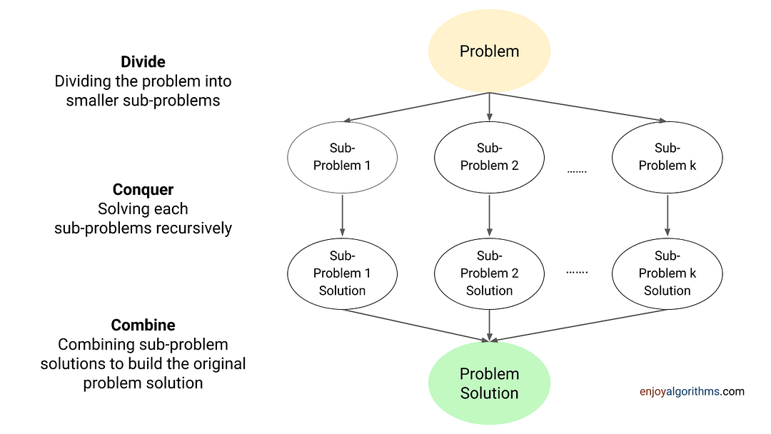
Divide and Conquer
Notes:
Binary Search is Decrease and Conquer as it solves a problem of size n by solving one sub-problem of n/2 size.

Slide 26
Divide-and-Conquer
Most common usage.
Break up problem of size n into two equal parts of size ½n.
Solve two parts recursively.
Combine two solutions into overall solution in linear time.
Consequence.
Brute force: n².
Divide-and-conquer: n log n.

Slide 27
Mergesort
Mergesort.
Divide array into two halves.
Recursively sort each half.
Merge two halves to make sorted whole.
A
L
G
O
R
I
T
H
M
S
A
L
G
O
R
I
T
H
M
S
divide
O(1)
A
G
L
O
R
H
I
M
S
T
sort
2T(n/2)
A
G
H
I
L
M
O
R
S
T
merge
O(n)

Slide 28
Merging
Merging. Combine two pre-sorted lists into a sorted whole.
How to merge efficiently?
Linear number of comparisons.
Use temporary array.
A
G
L
O
R
H
I
M
S
T
A
G
H
I

Slide 29
A Useful Recurrence Relation
Def. T(n) = number of comparisons to mergesort an input of size n.
Mergesort recurrence.
Solution. T(n) = O(n log₂ n).
Assorted proofs. We describe several ways to prove this recurrence. Initially we assume n is a power of 2 and replace ≤ with =.

Slide 30
Proof by Recursion Tree
T(n)
n
T(n/2)
T(n/2)
2(n/2)
T(n/4)
T(n/4)
T(n/4)
T(n/4)
4(n/4)
log₂n
. . .
T(n / 2^{k})
2^{k} (n / 2^{k})
. . .
T(2)
T(2)
T(2)
T(2)
T(2)
T(2)
T(2)
T(2)
n/2 (2)
n log₂n

Slide 31
Proof by Telescoping
Claim. If T(n) satisfies this recurrence, then T(n) = n log₂ n.
Pf. For n > 1:
assumes n is a power of 2

Slide 32
Proof by Induction
Claim. If T(n) satisfies this recurrence, then T(n) = n log₂ n.
Pf. (by induction on n)
Base case: n = 1.
Inductive hypothesis: T(n) = n log₂ n.
Goal: show that T(2n) = 2n log₂ (2n).
assumes n is a power of 2

Slide 33
Merging
Merge.
Keep track of smallest element in each sorted half.
Insert smallest of two elements into auxiliary array.
Repeat until done.
smallest
smallest
A
G
L
O
R
H
I
M
S
T
A
auxiliary array

Slide 34
Merging
Merge.
Keep track of smallest element in each sorted half.
Insert smallest of two elements into auxiliary array.
Repeat until done.
smallest
smallest
A
G
L
O
R
H
I
M
S
T
A
G
auxiliary array

Slide 35
Merging
Merge.
Keep track of smallest element in each sorted half.
Insert smallest of two elements into auxiliary array.
Repeat until done.
smallest
smallest
A
G
L
O
R
H
I
M
S
T
A
G
H
auxiliary array

Slide 36
Merging
Merge.
Keep track of smallest element in each sorted half.
Insert smallest of two elements into auxiliary array.
Repeat until done.
smallest
smallest
A
G
L
O
R
H
I
M
S
T
A
G
H
I
auxiliary array

Slide 37
Merging
Merge.
Keep track of smallest element in each sorted half.
Insert smallest of two elements into auxiliary array.
Repeat until done.
smallest
smallest
A
G
L
O
R
H
I
M
S
T
A
G
H
I
L
auxiliary array

Slide 38
Merging
Merge.
Keep track of smallest element in each sorted half.
Insert smallest of two elements into auxiliary array.
Repeat until done.
smallest
smallest
A
G
L
O
R
H
I
M
S
T
A
G
H
I
L
M
auxiliary array

Slide 39
Merging
Merge.
Keep track of smallest element in each sorted half.
Insert smallest of two elements into auxiliary array.
Repeat until done.
smallest
smallest
A
G
L
O
R
H
I
M
S
T
A
G
H
I
L
M
O
auxiliary array

Slide 40
Merging
Merge.
Keep track of smallest element in each sorted half.
Insert smallest of two elements into auxiliary array.
Repeat until done.
smallest
smallest
A
G
L
O
R
H
I
M
S
T
A
G
H
I
L
M
O
R
auxiliary array

Slide 41
Merging
Merge.
Keep track of smallest element in each sorted half.
Insert smallest of two elements into auxiliary array.
Repeat until done.
first half exhausted
smallest
A
G
L
O
R
H
I
M
S
T
A
G
H
I
L
M
O
R
S
auxiliary array

Slide 42
Merging
Merge.
Keep track of smallest element in each sorted half.
Insert smallest of two elements into auxiliary array.
Repeat until done.
first half exhausted
smallest
A
G
L
O
R
H
I
M
S
T
A
G
H
I
L
M
O
R
S
T
auxiliary array

Slide 43
Merging
Merge.
Keep track of smallest element in each sorted half.
Insert smallest of two elements into auxiliary array.
Repeat until done.
first half exhausted
second half exhausted
A
G
L
O
R
H
I
M
S
T
A
G
H
I
L
M
O
R
S
T
auxiliary array

Slide 44
Counting Inversions
https://www.topcoder.com/thrive/articles/count-inversions-in-an-array

Slide 45
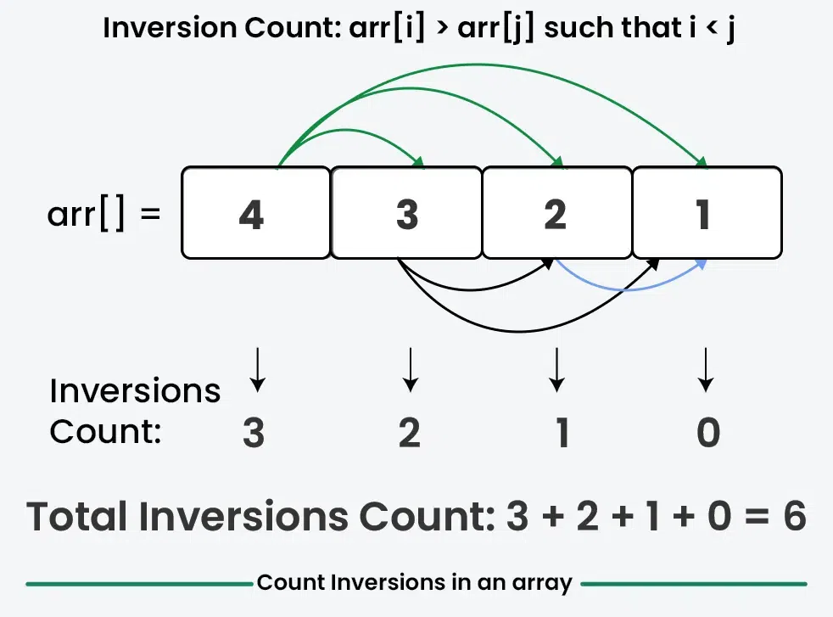
Counting Inversions

Slide 46
Counting Inversions
Music site tries to match your song preferences with others.
You rank n songs.
Music site consults database to find people with similar tastes.
Similarity metric: number of inversions between two rankings.
My rank: 1, 2, …, n.
Your rank: a₁, a₂, …, a_{n}.
Songs i and j inverted if i <= j, but a_{i} > a_{j}.
Brute force: check all Θ(n²) pairs i and j.
Songs
A
B
C
D
E
Me
1
2
3
4
5
Inversions
3-2, 4-2
You
1
3
4
2
5
Notes:
amazon.com, launch.com, restaurants, movies, . . .
Note: there can be a quadratic number of inversions.
Asymptotically faster algorithm must compute total number without even looking at each inversion individually.

Slide 47
Counting Inversions: Divide-and-Conquer
Divide-and-conquer.
1
5
4
8
10
2
6
9
12
11
3
7

Slide 48
Counting Inversions: Divide-and-Conquer
Divide-and-conquer.
Divide: separate list into two pieces.
1
5
4
8
10
2
6
9
12
11
3
7
Divide: O(1).
1
5
4
8
10
2
6
9
12
11
3
7

Slide 49
Counting Inversions: Divide-and-Conquer
Divide-and-conquer.
Divide: separate list into two pieces.
Conquer: recursively count inversions in each half.
1
5
4
8
10
2
6
9
12
11
3
7
Divide: O(1).
1
5
4
8
10
2
6
9
12
11
3
7
Conquer: 2T(n / 2)
5 blue-blue inversions
8 green-green inversions
5-4, 5-2, 4-2, 8-2, 10-2
6-3, 9-3, 9-7, 12-3, 12-7, 12-11, 11-3, 11-7

Slide 50
Counting Inversions: Divide-and-Conquer
Divide-and-conquer.
Divide: separate list into two pieces.
Conquer: recursively count inversions in each half.
Combine: count inversions where a_{i} and a_{j} are in different halves, and return sum of three quantities.
1
5
4
8
10
2
6
9
12
11
3
7
Divide: O(1).
1
5
4
8
10
2
6
9
12
11
3
7
Conquer: 2T(n / 2)
5 blue-blue inversions
8 green-green inversions
9 blue-green inversions
5-3, 4-3, 8-6, 8-3, 8-7, 10-6, 10-9, 10-3, 10-7
Combine: ???
Total = 5 + 8 + 9 = 22.

Slide 51
Counting Inversions: Divide-and-Conquer
How can we combine the results in O(n) time?
!!!Try Yourself!!!

Slide 52
!!!Try Yourself!!! – Algorithm to find Second MAX from an array
Derive an Divide & Conquer algorithm to find the Second MAX from an array of N elements and find the complexity of your algorithm.

Slide 54
!!!Try Yourself !!! - Two Dimensional Search
You are given an m × n matrix of numbers A, sorted in increasing order within rows and within columns. Assume m = O(n). Design an algorithm that finds the location of an arbitrary value x, in the matrix or report that the item is not present. Is your algorithm optimal?

